Slide 1
7th Grade Math Warm-ups
Week of October 24-28, 2016

Slide 2
Warm-up Monday, October 24, 2016

Slide 3
Warm-up Tuesday, October 25, 2016
1
2

Slide 4
Warm-up Wednesday, October 26, 2016
1.

Slide 5
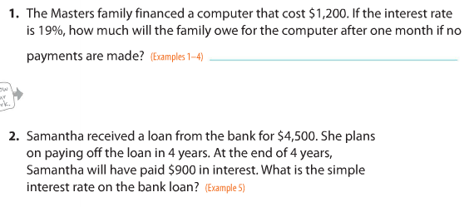
Warm-up Thursday, October 27, 2016

Slide 6
Warm-up Friday, October 28, 2016
No Warm-up
Turn in any missing assignments
Turn in your agenda book after copying your objective to me with your name on top of the page I will check
Take everything off your desk and prepare for your unit 2 exam

Slide 7
Pre-AP 7th Grade Math Warm-ups
Week of October 24-28, 2016

Slide 8
PreAP Warm-up Monday, October 24, 2016

Slide 9
Pre-AP warm-up Tuesday, October 25, 2016

Slide 10
Pre-AP warm-up Wednesday, Oct. 26, 2016

Slide 11
Pre-AP Warm-up Thursday, Oct. 27, 2016
No Warm-up
Copy your Objectives
Take everything off your desk and prepare for your unit 3 exam

Slide 12
Pre-AP warm-up Friday, October 28, 2016
No Warm-up
Turn in any missing assignments
Turn in your agenda book after copying your objective to me with your name on top of the page I will check
Take everything off your desk and prepare to complete your unit 3 exam

