Slide 1
7th Grade Math Warm-ups
Week of December 5-9, 2016

Slide 2
Warm-up Monday, December 5, 2016

Slide 3
Warm-up Tuesday, December 6, 2016
Use a list or a tree to determine the sample space

Slide 4
Warm-up Wednesday, December 7, 2016
Use a list or a tree to determine the sample space

Slide 5
Warm-up Thursday, December 8, 2016
Use a list or a tree to determine the sample space

Slide 6
Warm-up Friday, December 9, 2016

Slide 7
Pre-AP 7th Grade Math Warm-ups
Week of December 5-9, 2016

Slide 8
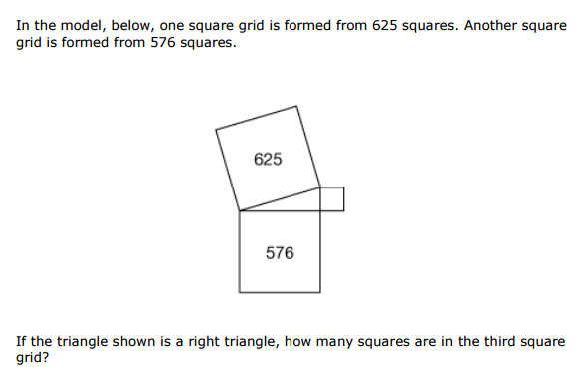
PreAP Warm-up Monday, December 5, 2016

Slide 9
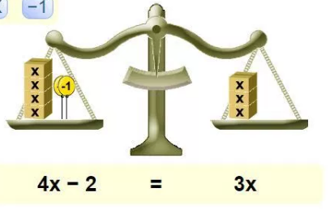
Pre-AP warm-up Tuesday, December 6, 2016

Slide 10
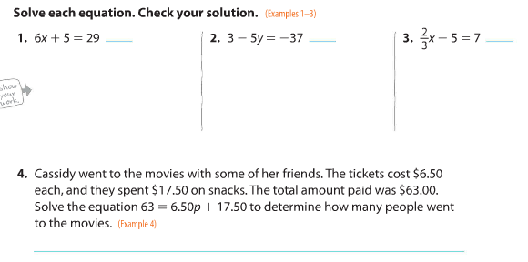
Pre-AP warm-up Wednesday, Dec. 7, 2016

Slide 11
Pre-AP Warm-up Thursday, Dec. 8, 2016

Slide 12
Pre-AP warm-up Friday, December 9, 2016

